Slide 1

Smart Research Assistant: Unlocking Knowledge with AI
Problem Statement: Current research tools lead to shallow knowledge, wasted time, and outdated information due to fragmentation and lack of reliable summarization with citations.
Team Name: Logix
Team Leader Name: Aayush Sinha
Institute Name: Klh University
Team Leader Email ID: 2420030518@klh.edu.in
Github Repository: https://github.com/2420030518-bit/Logix_hackwithIndia.git

Slide 2
The Research Conundrum & Our AI-Driven Solution
The Problem: Fragmented Research
Our Solution: Smart Research Assistant
Search engines provide links, not answers.
AI agent takes questions as input.
Chatbots lack multi-source integration.
Summarizes answers into reliable reports with citations.
Summarizers often miss citations, leading to mistrust.
Results in shallow knowledge and wasted time.
Connects uploaded files with live online data.
Keeps information updated with fresh news/blogs.

Slide 3

Building the Smart Research Assistant
Our systematic approach ensures a robust and intelligent research assistant, from user interaction to continuous data ingestion.
01
02
03
Frontend Application
Backend Agent Pipeline
Data Integration
User-friendly interface for question input and report viewing. Designed for intuitive navigation.
Orchestrates search, extraction, summarization, and citation generation for accuracy and speed.
Seamlessly combines uploaded files with diverse live web sources to ensure comprehensive results.
04
05
Incremental Ingestion (Pathway)
Report Generation
Continuously updates with fresh information from live sources like news and blogs, ensuring currency.
Creates structured, evidence-based reports with key takeaways and reliable sources, enhancing trustworthiness.

Slide 4







Core Technologies Driving Innovation
A blend of powerful tools forms the foundation of our Smart Research Assistant, ensuring advanced capabilities and reliability.
Advanced AI/NLP Models
Vector Databases
For intelligent summarization, accurate question answering, and precise information extraction.
Efficiently store and retrieve information from diverse sources, optimizing search and retrieval times.
Pathway Integration
Web Scraping & APIs
Enables incremental data ingestion for real-time updates from live sources, keeping information fresh.
For dynamic data collection from online sources, news feeds, and specialized databases.
Cloud Infrastructure
Flexprice Integration
Scalable and reliable hosting for the application and backend services, ensuring high availability.
Billing per question and per report generated, allowing for transparent usage tracking and cost efficiency.

Slide 5

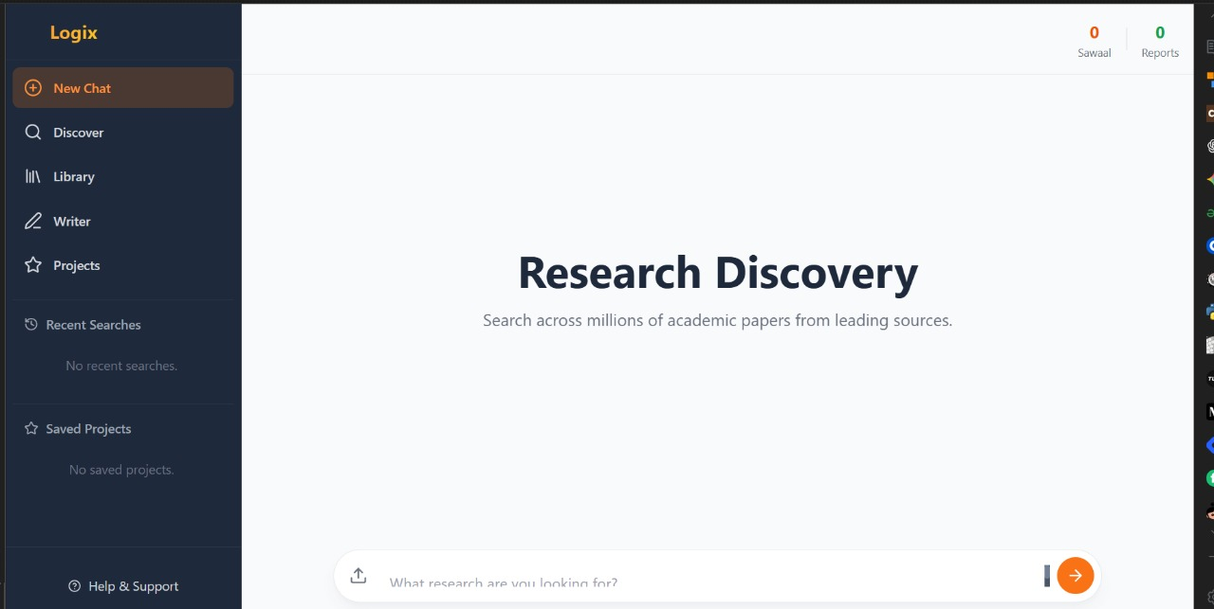
From Question to Insight: The System Flow
This flowchart illustrates the seamless journey of a user query through our Smart Research Assistant, transforming questions into actionable insights.
Screenshot of Model
User Query
Backend Agent
Extract & Summarize
Generate Report
The diagram above visually represents the efficient, multi-step process our system undertakes to deliver comprehensive, cited research reports in response to user queries.

Slide 6



Market Potential & Viability
The Smart Research Assistant addresses a critical need for efficient and reliable information access across various sectors, demonstrating significant market viability.
Academic Users
Startup Teams
Professionals
Students and teachers can utilize it for assignments, reports, and comprehensive lesson planning, ensuring academic rigor.
For market research, competitive analysis, and business intelligence, enabling data-driven decision-making for rapid growth.
Consultants, analysts, and researchers needing quick, cited insights to inform strategies and recommendations.
Monetization
Our SaaS model allows users to pay per question asked and per report generated, leveraging our integrated Flexprice system for transparency and scalability.

Slide 7
Conclusion: Smarter Research, Faster Insights
The Smart Research Assistant is poised to revolutionize how we access and utilize information, providing a new paradigm for efficient and reliable discovery.
Transformative Impact: Eliminates fragmented tools, saving time and delivering deep knowledge with trustable insights and reliable citations.
Key Differentiators: Multi-source integration, robust summarization with citations, and real-time data freshness ensure unparalleled accuracy and relevance.
Future Growth: Strong SaaS potential with a clear, scalable monetization strategy based on a pay-per-use model, ensuring sustainable development.
Our Smart Research Assistant is not just a tool; it's a new paradigm for efficient, reliable, and intelligent information discovery, empowering users across all sectors.

